Slide 1
GIS Primer for Landscape Ecology
Ben Best Jan 8, 2015

Slide 2
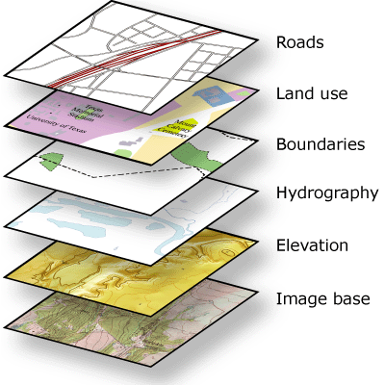
GIS: Layers of Data
A geographic information system (GIS) integrates hardware, software, and data for capturing, managing, analyzing, and displaying all forms of geographically referenced information.
GIS allows us to view, understand, question, interpret, and visualize data in many ways that reveal relationships, patterns, and trends in the form of maps, globes, reports, and charts.
GIS first termed by Roger Tomlinson (1968) A Geographic Information System for Regional Planning

Slide 3
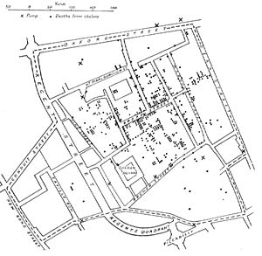
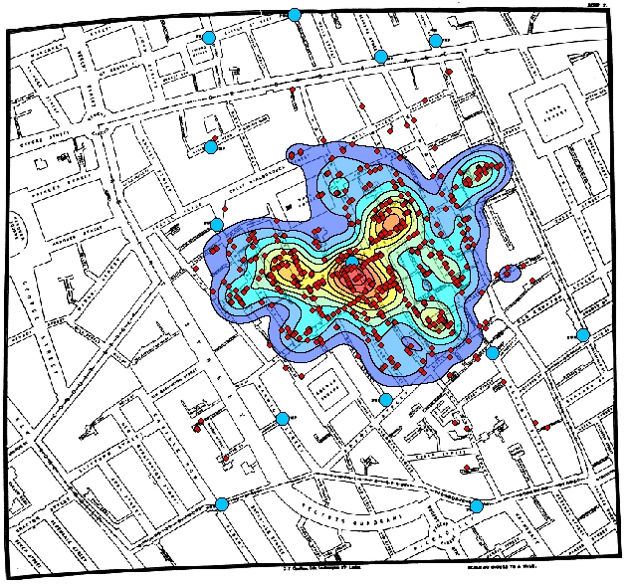
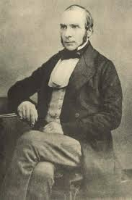
History
THEN
NOW
First “GIS”: John Snow’s 1855 map of 1854 cholera outbreak in London spatially related to wells. Epidemiology.

Slide 4
Outline
Projections
Data
ArcGIS Applications
Browse with ArcCatalog
Map with ArcMap
Model with Model Builder (geoprocessing)
Editing

Slide 5
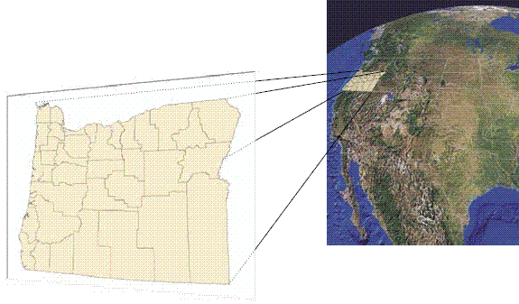
Georeferencing

Slide 6
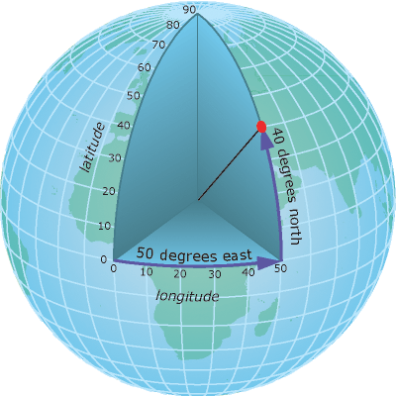
Spherical Earth

Slide 7
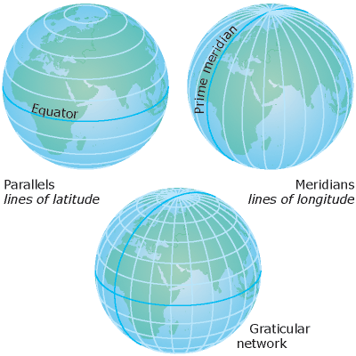
Geographic Coordinate System

Slide 8
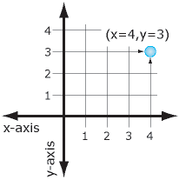
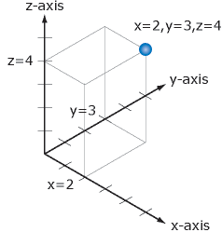
Cartesian Coordinates

Slide 9
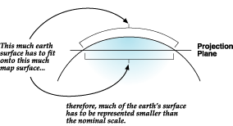
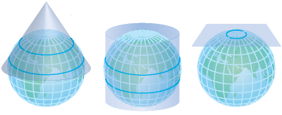
Map Projections
Geographic to Projected Coordinate System
Unlike a geographic coordinate system, a projected coordinate system has constant lengths, angles, and areas across the two dimensions. However, all map projections representing the earth's surface as a flat map create distortions in some aspect of distance, area, shape, or direction.

Slide 10
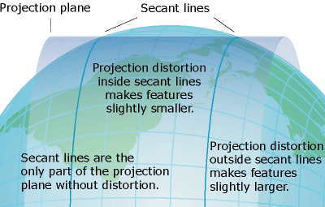

Slide 11
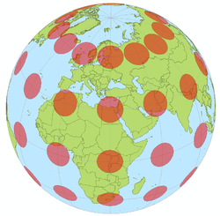
Visualizing Distortion of Projections
Tissot’s Indicatrix
Distortions, at least 1 or more:
Distance
Angle
Area
view from space of geographic coordinate system
Notes:
Tissot’s indicatrix (Tissot indicatrix, Tissot’s ellipse, Tissot ellipse, ellipse of distortion) is a mathematical contrivance presented by French mathematician Nicolas Auguste Tissot in 1859 and 1871 in order to characterize distortions due to map projection. It is the geometry that results from projecting a circle of infinitesimal radius from a curved geometric model, such as a globe, onto a map. Tissot proved that the resulting diagram is an ellipse whose axes indicate the two principal directions along which scale is maximal and minimal at that point on the map.

Slide 12
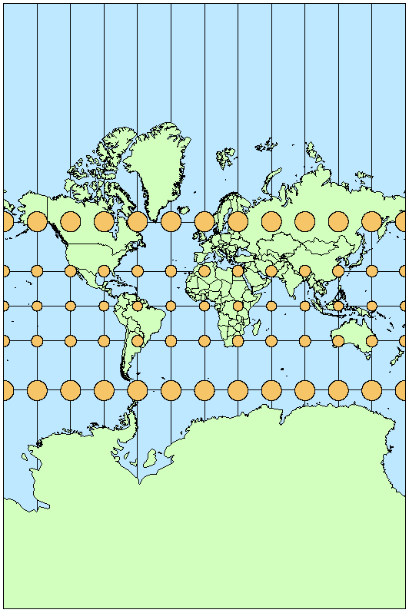
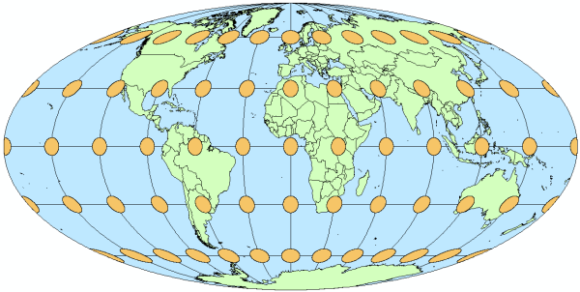
Equal Angle or Area
Equal area (distorted angle): Mollweide
Conformal (preserved angle, distorted area): Mercator
Notes:
Tissot’s indicatrix (Tissot indicatrix, Tissot’s ellipse, Tissot ellipse, ellipse of distortion) is a mathematical contrivance presented by French mathematician Nicolas Auguste Tissot in 1859 and 1871 in order to characterize distortions due to map projection. It is the geometry that results from projecting a circle of infinitesimal radius from a curved geometric model, such as a globe, onto a map. Tissot proved that the resulting diagram is an ellipse whose axes indicate the two principal directions along which scale is maximal and minimal at that point on the map.

Slide 13
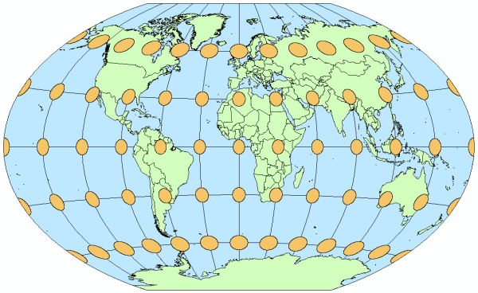
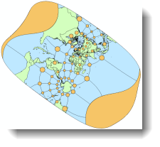
Compromise Projection
Oblique Mercator
Compromise projection (vary in size, shape, angle): Winkel Tripel

Slide 14
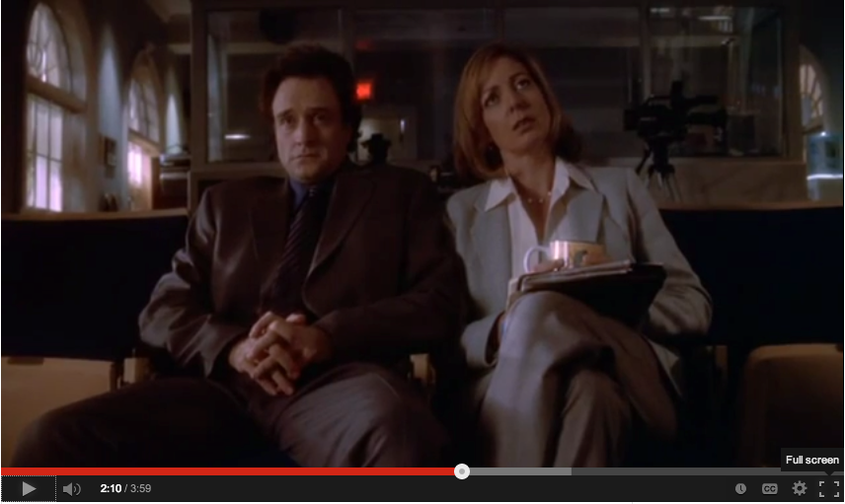
Why are We changing the Maps?
“Because … the Mercator projection has fostered European imperialist attitudes for centuries and created an ethnic bias against the Third World….” says the Organization of Cartographers for Social Equality [West Wing season 2, episode 16]
http://www.youtube.com/watch?v=vVX-PrBRtTY

Slide 15
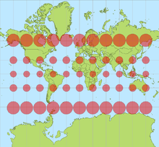
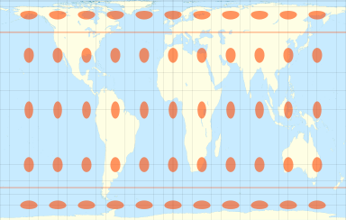
Why are We changing the Maps?
“Because … the Mercator projection has fostered European imperialist attitudes for centuries and created an ethnic bias against the Third World….” says the Organization of Cartographers for Social Equality [West Wing season 2, episode 16]
Mercator
Galls-Peters

Slide 16
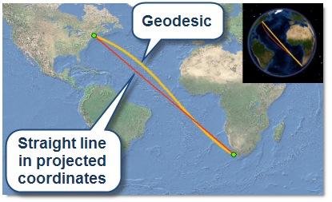
Geodesic Distance, Area & Buffer
geodesic = shortest distance along surface of a geoid (aka spheroid)
New to ArcGIS 10.1, so often do not need to project layers from geographic.

Slide 17
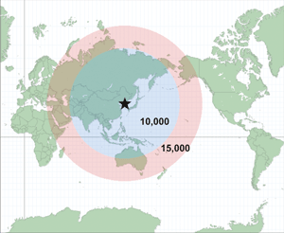
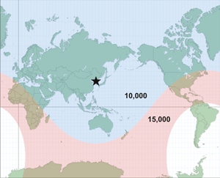
Geodesic Real World Example
“Ranges” for missiles launched from North Korea
Originally published map
in major newspaper
Updated true buffer distance map (2 weeks later)

Slide 18
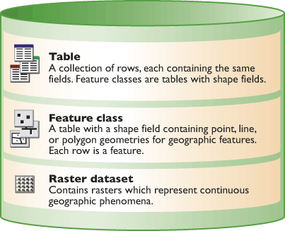
Common Data Types
Most common file extensions:
*.dbf – dbase
Vector
*.shp - shapefile (*.dbf, *.shx…)
Imagery
*.tif - GeoTIFF
Geodatabase
*.gdb folder

Slide 19
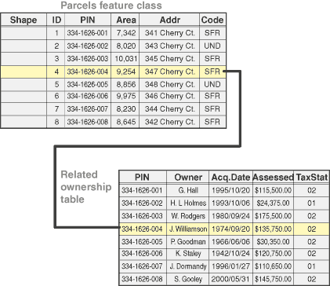
Table Basics
Rows, Columns
Data types: integer, float, character, date
Relationships

Slide 20
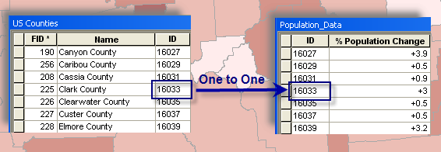
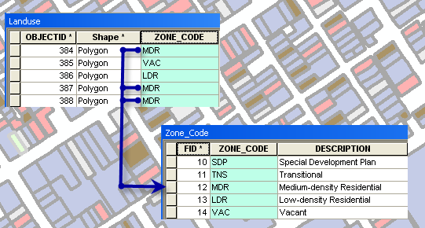
Table Relationships
One to One: Join
One to Many: Relate

Slide 21
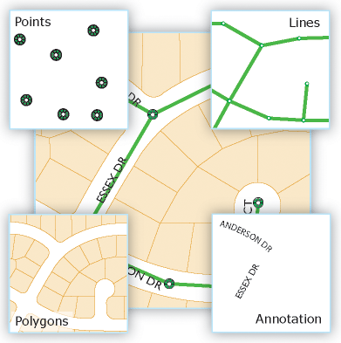
Feature Classes (aka Vector)

Slide 22
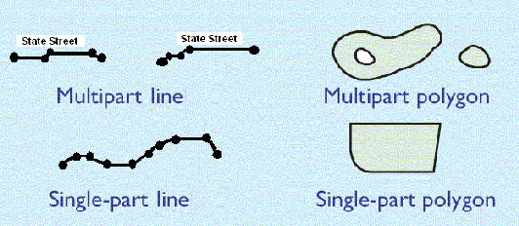
Vector: Multipart

Slide 23
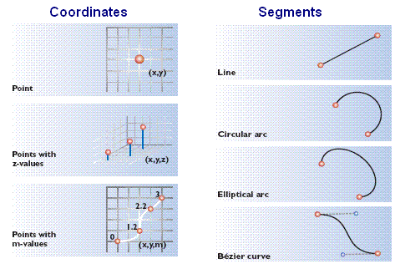
Vector

Slide 24
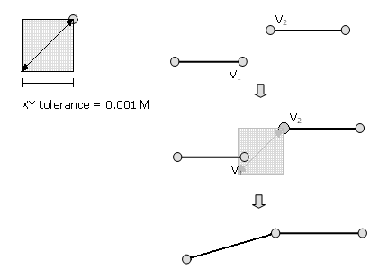
Vector: Tolerance
Influences snapping behavior between vertices when editing or performing spatial analysis.

Slide 25
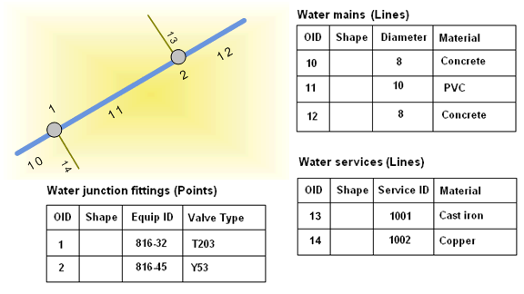
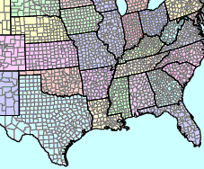
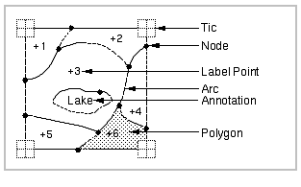
Vector: Topology
Topology: sharing of edges, boundaries, nodes amongst features.
linear features connected, eg water network
Polygon features share edges
Can be explicitly handled during editing of feature classes in geodatabase, but only implicitly with shapefile tolerances. Legacy of “coverages”.

Slide 26
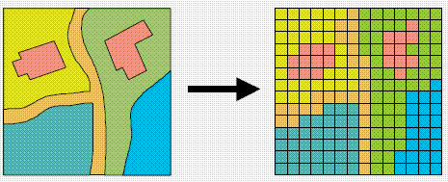
Raster
“Raster is faster, but vector is corrector.”
Notes:
For example, you can simply sum the number of pixels multiply cell area and get area. Much more cpmplicated to calculate area of a vector polygon.

Slide 27
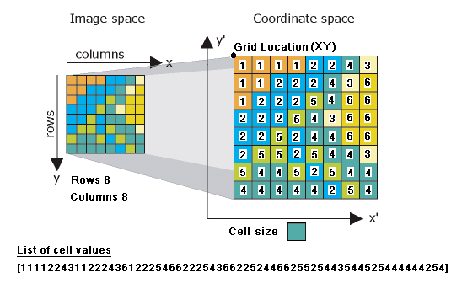
Raster

Slide 28
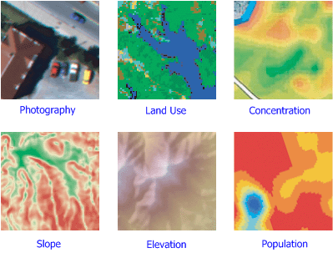
Raster Uses

Slide 29
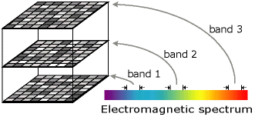
Raster: Bands

Slide 30
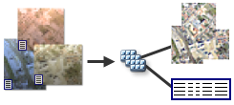
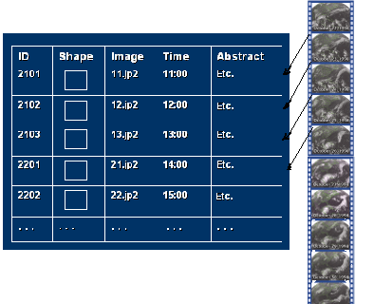
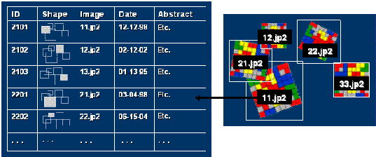
Extending Rasters
Mosaic Datasets
Raster Catalogs
Time series
Any series

Slide 31
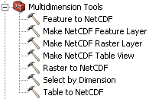
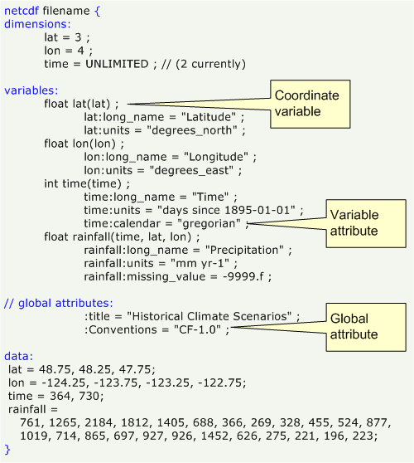
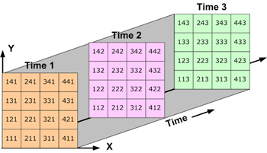
NetCDF
multidimensional scientific data format developed open source by climate scientist community

Slide 32
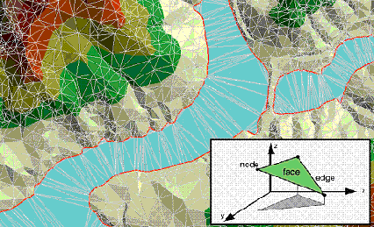
Triangulated Irregular Network (TIN)
TINs are much less common than other formats, but sometimes used as a simplified representation of a raster surface.

Slide 33
Geodatabases (gdb)
Personal geodatabase
Single file Microsoft Access database (*.mdb) with spatial tables, so Query wizard
2 GB / db
Only Windows
File geodatabase (recommended)
Folder (*.gdb) of files
1 TB / dataset, 256 TB / image
Cross platform
Enterprise geodatabase
Complex, multi-user environments
MS SQL Server, Oracle, PostgreSQL

Slide 34
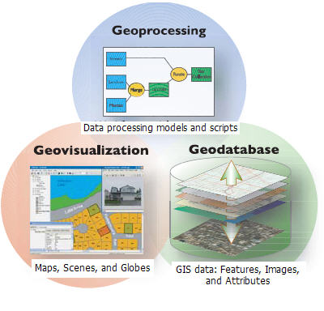
ArcGIS Desktop
Licensing:
ArcInfo (most)
ArcEditor
ArcView (least)
ArcCatalog
(Model Builder)
ArcMap
ArcScene
ArcGlobe
ArcCatalog

Slide 35
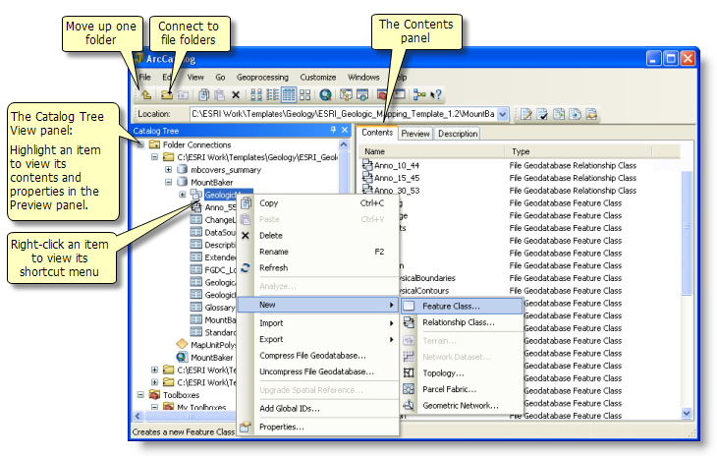
ArcCatalog
Like Windows Explorer for your spatial data files.

Slide 36
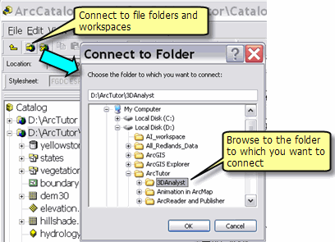
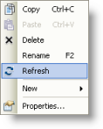
Connect to Folder, Refresh
Have to Connect to Folder before being able to browse.
Often need to refresh to see newly generated layers

Slide 37
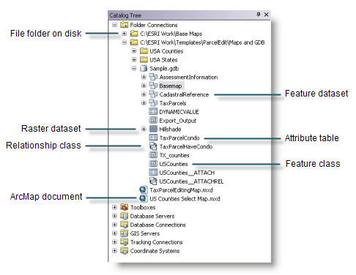
Items in Catalog tree

Slide 38
ArcCatalog: Preview pane

Slide 39
ArcCatalog: Description pane
= Metadata

Slide 40
ArcCatalog: Create New Data

Slide 41
Setup Map Document (*.mxd)
Default geodatabase
Relative pathnames recommended!

Slide 42
ArcMap: Data View

Slide 43
ArcMap: Layout View
for printing

Slide 44
Add Layers
Add Data button for accessing local data
or drag from Catalog window
Note: you need to have the folder “connected” first before being able to browse.

Slide 45
Add Layers
Add data arrow, Add data from ArcGIS Online

Slide 46
Table of Contents: Layer Symbology

Slide 47
Layer Properties: Symbology

Slide 48
Layer Symbology

Slide 49
Layer Symobology

Slide 50
Layer Symobology

Slide 51
Layer subset: Definition Query

Slide 52
Identifying features
Click on the Identify tool

Slide 53
Select Features Interactively

Slide 54
Select Features by Attribute
Click Selection > Select By Attributes
Standard Query Language (SQL)

Slide 55
Select Features by Location
Click Selection > Select By Location

Slide 56
Cartography

Slide 57
ArcMap: Data View

Slide 58
ArcMap: Layout View
for printing

Slide 59
Layout editing and printing

Slide 60
Add an Extent Indicator Map
Use multiple data frames in a single Layout view

Slide 61
Geoprocessing
Identify Goal / Question.
Prep Data.
Model. Build the analysis model (typically performed using geoprocessing, but could be as simple as a few mouse clicks in ArcMap). Execute the model and generate results.
Visualize. Explore, evaluate, chart, summarize, interpret, visualize, understand, and analyze the results. Make decisions and articulate your conclusions.
Iterate

Slide 62
Geoprocessing: common tasks
Reprojecting a dataset from one coordinate system to another
Adding a field to a table

Slide 63
Geoprocessing: common tasks
Generating buffer zones around features
Overlaying multiple sets of polygons
… http://resources.arcgis.com/en/help/main/10.1/index.html#/An_introduction_to_the_commonly_used_GIS_tools/018p00000002000000/

Slide 64
Finding Tools
Some in Geoprocessing menu found on the Standard toolbar
Search window

Slide 65
Finding Tools
Some in Geoprocessing menu found on the Standard toolbar
Search window
Browse in the Catalog window

Slide 66
Finding Tools
Some in Geoprocessing menu found on the Standard toolbar
Search window
Browse in the Catalog window
Browse in the ArcToolbox window

Slide 67
Tool dialog and results

Slide 68
Models & ModelBuilder
Scientific Workflow
Repeatable
Updatable
Easy to read
Model > Export > To Python Script

Slide 69
Environment Settings
Settings used varies by tool. For instance, with Polygon to Raster tool:
Snap raster
Cell size
Output Coordinate System
Extent

Slide 70
Python Window
Run from the Python window
Advantages: easily repeatable, simple text

Slide 71
Tip: use Python Snippets
Use tool dialog to run.
Once finished, right-click in Results window click Copy As Python Snippet.
Paste into text file with your Python code.
arcpy.Clip_analysis("E:/Example.gdb/streets", "E:/Example.gdb/StudyArea”, "E:/Example.gdb/streets_Clip","#")

Slide 72
Add Spatial Analyst Extension
Click Customize > Extensions from the main menu in any ArcGIS application.

Slide 73
Editing

Slide 74
Editing
Add the Editor toolbar

Slide 75
Editing

